Slide 1

ENHANCING EDUCATION THROUGH PREDICTIVE ANALYTICS: A STUDY ON STUDENT PERFORMANCE PREDICTION
CALIFORNIA STATE UNIVERSITY, NORTHRIDGE
A Thesis submitted in partial fulfillment of the requirements for the degree of
Master of Science in Computer Science
By
Sandya Bethina

Slide 2
TABLE OF CONTENT
Introduction
Objectives
Scope
Proposed Process
Data Description
Data Analysis & Visualization
Methodology & Models Used
Explainable AI (XAI) Analysis
Advanced Techniques
Model Comparison
Conclusion
Future Scope

Slide 3
INTRODUCTION

Slide 4
PROJECT DESCRIPTION:
The project aims to improve educational outcomes using predictive analytics by analyzing student data like attendance, grades, and participation. Machine learning algorithms uncover key factors influencing academic success, providing educators with actionable insights to support underperforming students. The project enhances learning experiences through data-driven strategies to boost performance and retention. The predictive model can be integrated into educational systems, offering real-time feedback for proactive measures.

Slide 5
PROBLEM STATEMENT:
To improve educational outcomes among diverse students, this project leverages predictive analytics and machine learning to analyze data like attendance, grades, and participation. By developing a predictive model that identifies patterns influencing student success, educators can provide personalized support to at-risk students. This data-driven approach enhances learning experiences and fosters an inclusive environment where no student is left behind.

Slide 6
OBJECTIVES:
1. Data Collection & Analysis: Gather and analyze student data (attendance, grades, participation) to find key performance trends.
2. Model Development: Build ML models to predict student outcomes and identify at-risk students early.
3. Personalized Interventions: Provide insights for tailored support to improve student success.
4. System Integration: Embed predictive tools into learning platforms for real-time feedback.
5. Continuous Improvement: Evaluate and refine models and strategies for better accuracy and impact.

Slide 7
SCOPE:
1. Student Data Integration: Combine attendance, grades, participation, and demographics into one dataset for analysis.
1
2. Predictive Modeling: Develop machine learning models to predict student performance and key success factors.
2
3. Intervention Strategies: Create practical support methods to help students identified as at risk.
3
4. Real-time Feedback: Provide instant insights for teachers and students to improve learning outcomes.
4

Slide 8
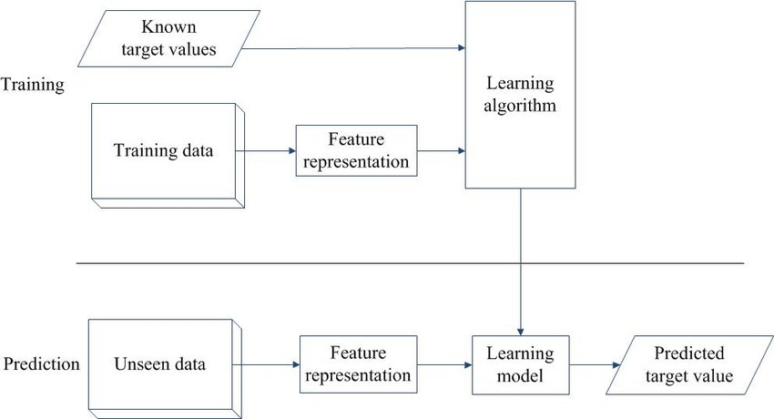
PROPOSED PROCESS:

Slide 9

DATA DESCRIPTION

Slide 10
DATA DESCRIPTION:
The "Open University Learning Analytics Dataset" (OULAD) provides data to support educational analytics research.
It includes data from 32,593 students across seven courses, analyzing factors like success and retention.
Key features cover student demographics, course structure, VLE interactions, and assessment scores to track performance.
Demographics like age, gender, and education level offer context for analyzing differences in academic outcomes.
With its detailed structure, OULAD is ideal for data mining, machine learning, and predictive studies in education.
We can access the dataset [here].

Slide 11
FEATURE DESCRIPTION:
Feature Category | Feature | Description
 | Student ID | Unique identifier for each student.
 | Gender | Indicates the student's gender (Male/Female).
Student Demographics | Age Band | Categorized age ranges such as “0-35” or “35+”.
 | Region | Geographic location within the UK.
 | Disability | Whether the student has declared a disability (Yes/No).
 | Highest Education Level | The highest educational qualification attained (e.g., "A Level", "HE Qualification").
 | Code Module | Unique code for each course module.
Course and Module Information | Code Presentation | Year and semester code for each course presentation.
 | Module Length | Duration of the course module in weeks.
Virtual Learning Environment (VLE) | Site Type | Type of activity or page accessed (e.g., quizzes, forums).
 | Sum Click | Total clicks on VLE pages, representing engagement level.
Assessment Information | Assessment ID | Unique identifier for each assessment in a course module.
 | Assessment Type | Type of assessment (e.g., “CMA” for Computer-Marked, “TMA” for Tutor-Marked).
 | Date Submitted | Submission date for the assessment.
 | Score | Score achieved by the student in each assessment.

Slide 12
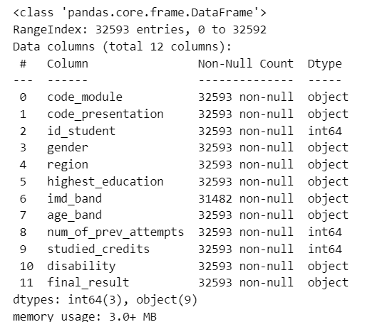
INFORMATION OF DATASET:
The OULAD student dataset includes demographics, education, and academic outcomes for 32,593 students.
Key features cover gender, region, age band, highest education level, and disability status.
The "imd_band" feature shows socio-economic status, with some missing values.
num_of_prev_attempts" reflects prior attempts, potentially predicting student performance.
final_result" categorizes outcomes (Pass, Fail, Withdrawn, Distinction), aiding in academic success analysis.

Slide 13
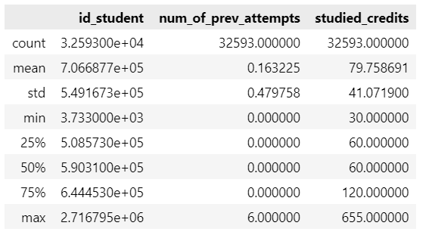
STATISTICAL DESCRIPTION:
The student ID system is unique, with large average values not trend-related.
Most students (median 0 attempts) are taking the course for the first time.
A few students attempted multiple times, with a maximum of six attempts.
Average credits studied is 80, with a wide range of values observed.
Maximum credits at 655 likely represent multiple modules or data outliers.

Slide 14
DATA ANALYSIS & VISUALIZATION

Slide 15
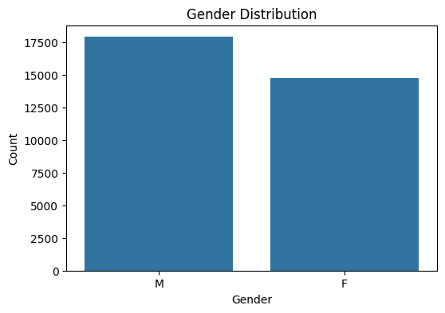
GENDER DISTRIBUTION:
The count plot shows a slight gender imbalance, with more females than males.
This imbalance may affect gender-based analyses, making accurate interpretation essential for relevant variables.

Slide 16
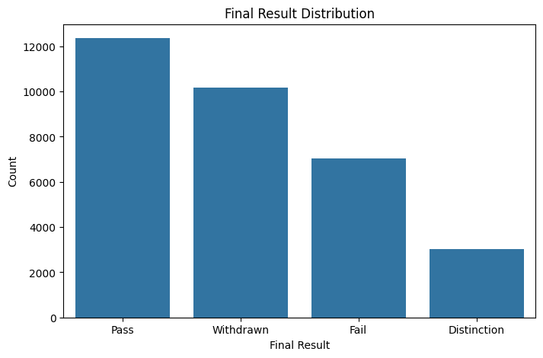
DISTRIBUTION OF FINAL RESULT:
The bar chart shows most students achieved a "Pass," with many also "Withdrawing."
A high withdrawal rate suggests challenges that lead students to discontinue studies.
Few students achieved "Distinction," indicating a minority excelling in academic performance.

Slide 17
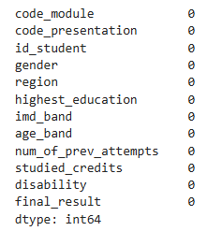
MISSING VALUE INSPECTION:
The table indicates most features have no missing values, reflecting high data completeness across the dataset.
The `imd_band` feature has 1,111 missing values, affecting analysis of socio-economic influences on outcomes.
Imputing `imd_band` values could enhance reliability for socio-economic analysis, providing deeper academic performance insights.

Slide 18
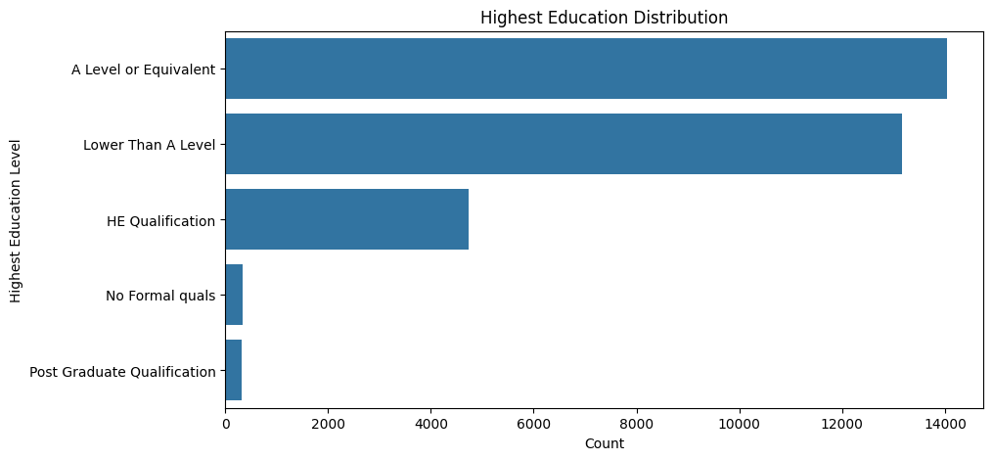
DISTRIBUTION OF HIGHEST EDUCATION:
Most students have "A Level" or "Lower Than A Level" qualifications.
Fewer students possess "HE Qualification" or "Post Graduate Qualification" backgrounds.
This distribution aids in analyzing how prior education impacts academic performance.

Slide 19
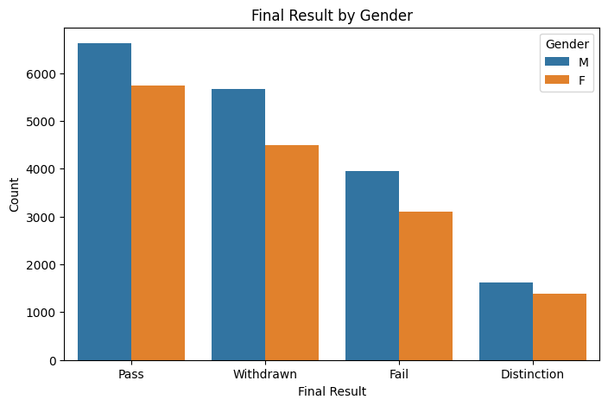
FINAL RESULT VS GENDER COMPARISON:
The count plot shows similar final result trends for both genders.
Both males and females have high "Pass" counts with consistent outcome distributions.
Slightly higher female enrollment may influence distribution but not individual success rates.

Slide 20
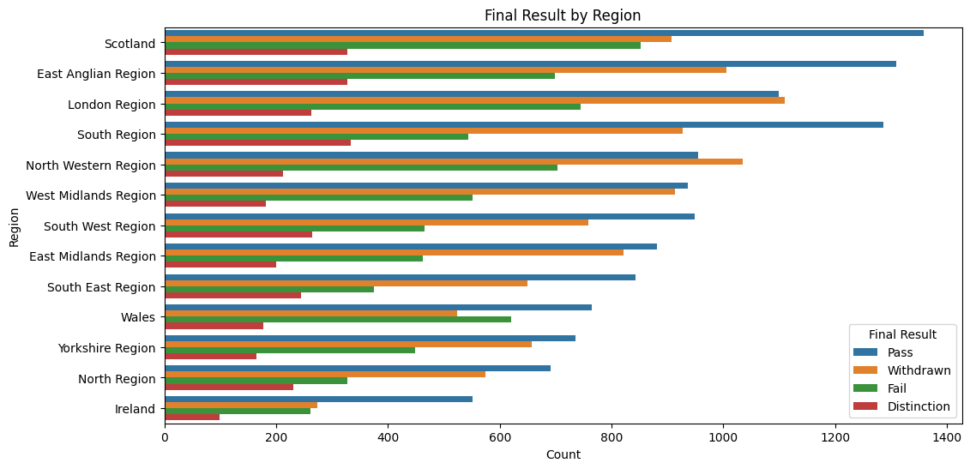
FINAL RESULT VS REGION COMPARISON:
The graph shows regional variation in final results, including pass, fail, and withdrawal rates.
Most regions display high "Pass" counts, with consistent performance in areas like Scotland.
"Withdrawn" rates are higher in regions like East Anglia and the South East.
Few students achieve "Distinction," indicating limited high achievement across all regions.

Slide 21
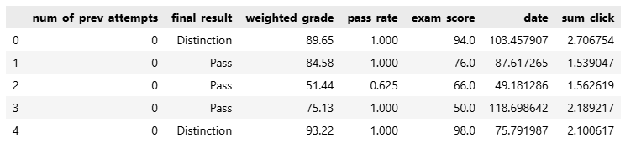
FINAL FEATURES FOR MODEL IMPLEMENTATION
Data Collection: Gathered student performance data from various datasets, including grades, attendance, and engagement metrics.
Data Merging: Merged multiple datasets (academic records, behavioral data) into a unified table for analysis.
Feature Engineering: Created new features like pass rate, weighted grade, and total clicks for better prediction.
Data Preprocessing: Cleaned missing values, normalized numerical data, and encoded categorical variables for consistency.

Slide 22

METHDOLOGY & MODELS USED

Slide 23
LOGISTIC REGRESSION:
Used to predict student performance (Pass or Fail).
Trained using features like final_result, weighted_grade, and pass_rate.
Each feature’s impact is tested individually to see how it influences predictions.
Uses the sigmoid function to convert results into probabilities.
Optimizes model weights to achieve higher accuracy with minimal error.

Slide 24
LOGISTIC REGRESSION EVALUATION:
The model achieves high accuracy (88%) using full `final_result` data, especially for "Pass.“
Dropping `weighted_grade` reduces accuracy to 87%, with minor drops in F1-scores.
Excluding `pass_rate` keeps accuracy at 87%, showing both features improve performance.
Retaining both features maximizes precision, especially distinguishing "Pass" and "Distinction" outcomes.

Slide 25
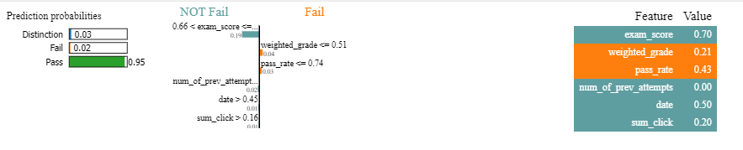
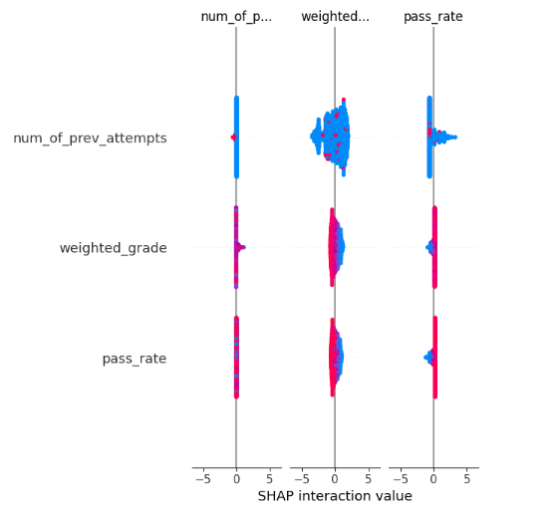
XAI FOR LR:
SHAP graph visualizes feature contributions to predictions.
Higher exam scores correlate with passing success.
Weighted grade positively impacts model's prediction outcome.
Previous attempts negatively influence student success rates.
Interaction values reveal combined feature effect on predictions.

Slide 26
RANDOM FOREST:
Predicts student performance using final_result, weighted_grade, and pass_rate.
Builds several decision trees on random data and merges results by majority voting.
Handles complex data, gives feature importance, and resists outliers.
Achieves high accuracy and highlights key factors affecting student outcomes. success.

Slide 27
RANDOM FOREST EVALUATION:
The Random Forest model achieves strong performance in predicting student outcomes across all scenarios.
With complete `final_result` data, the model attains 91% accuracy and a macro F1-score of 0.87.
Excluding `weighted_grade` lowers accuracy to 89%, showing it enhances but isn't essential.
Removing `pass_rate` reduces accuracy slightly to 90%, highlighting its positive yet non-critical impact.

Slide 28
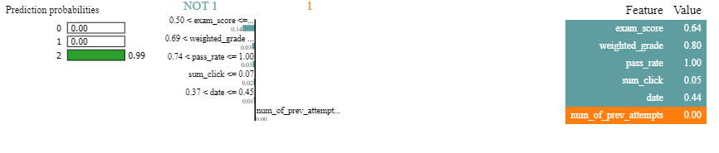
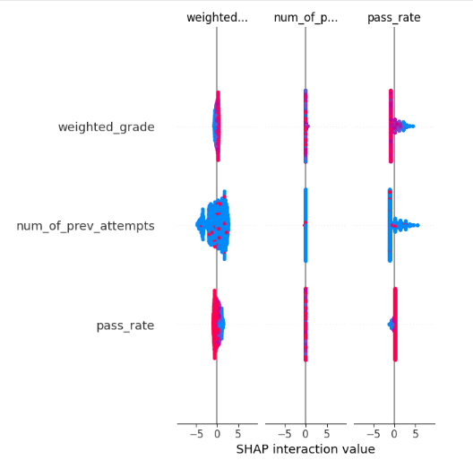
XAI FOR RANDOM FOREST:
SHAP values show feature contributions to predictions.
LIME approximates model behavior for interpretability.
High exam score indicates likelihood of success.
Weighted grade and pass rate influence outcomes.
LIME highlights influential features for specific predictions.

Slide 29
LDA
LDA is a supervised algorithm for classifying linearly separable data across multiple classes.
Maximizes the ratio of between-class variance to within-class variance for distinct boundaries.
Assumes Gaussian distribution within each class, unlike ensemble-based methods like Random Forest.
Analyzes features like grades to classify students as passing or failing effectively.
Provides interpretable insights by highlighting key features contributing to class separation.
Ideal for moderately sized datasets with straightforward relationships between predictors and outcomes.

Slide 30
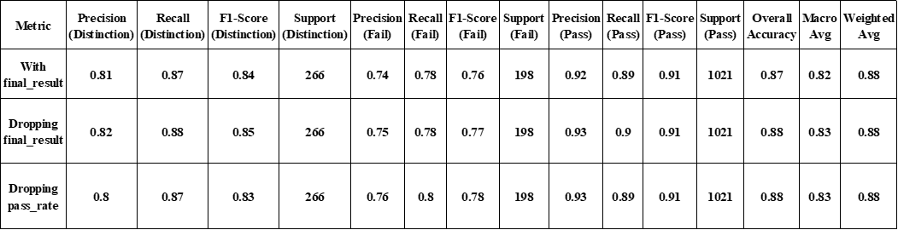
LDA EVALUATION:
Achieved 87% accuracy with final_result, and a Pass F1-score of 0.91.
Distinction precision: 0.81, recall: 0.87; Fail precision: 0.74, recall: 0.78.
Removing final_result improved accuracy to 88%, boosting overall precision and recall.
Pass category stayed strong (Precision 0.93, Recall 0.90).
Removing pass_rate kept accuracy at 88%, with minor drop in Distinction results.

Slide 31
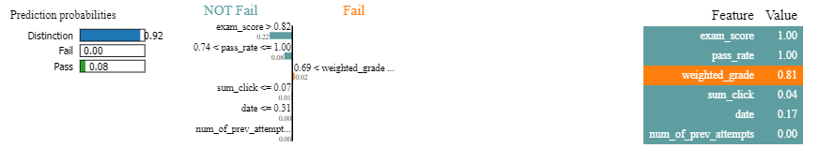
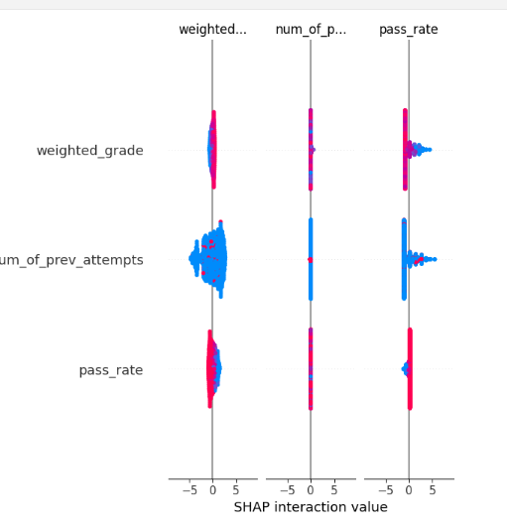
XAI FOR LDA:
High probability of "Distinction" (92%) predicted.
Higher exam score and pass rate preferred.
Lower weighted grade indicates "Fall" outcome.
Feature values: exam_score = 1.00, weighted_grade = 0.81.
LDA model separates classes using feature combinations.

Slide 32
XGBOOST
Powerful boosting algorithm for high accuracy and efficiency.
Handles large, complex datasets and missing values well.
Uses pass_rate, final_result, and weighted_grade to predict outcomes.
Boosts accuracy with regularization, tree pruning, and parallel processing.
Achieves strong precision, recall, and F1-scores across all categories.
Shows key influencing features and supports fast, reliable predictions.

Slide 33
XGBOOST EVALUATION:
The model shows strong performance across three test setups.
First setup: 90% accuracy, with highest precision and recall for Pass (F1 = 0.93).
Distinction scored precision 0.87, recall 0.80, F1 = 0.84; Fail performed slightly lower.
Second setup: Accuracy dropped to 88%, mainly due to lower Distinction results.
Pass and Fail stayed consistent with precision around 0.90 and 0.88.
Third setup: 89% accuracy with balanced results, showing model robustness.

Slide 34
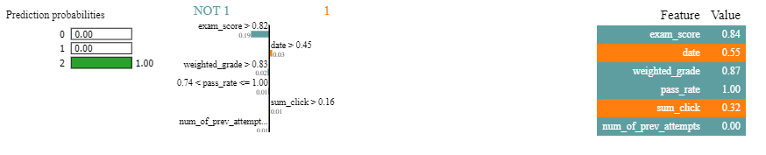
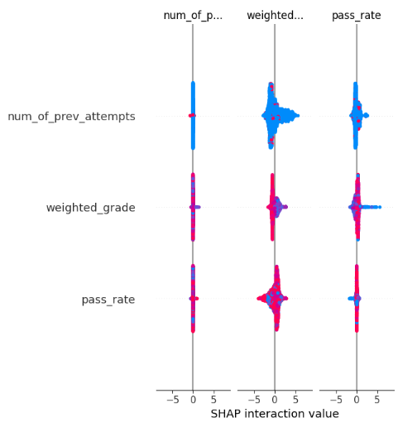
XAI FOR XGBOOST
SHAP values show feature contributions to predictions.
Model predicts Class 2 with high certainty.
High exam score and weighted grade influence.
Pass rate and sum_click also contribute.
Thresholds for features guide the prediction outcome.

Slide 35
CNN
Used to analyze student performance by detecting complex data patterns.
Combines Distinction and Pass into one class to focus on predicting success or failure.
Uses convolutional layers to extract trends from weighted_grade and pass_rate.
Pooling layers reduce data size while preserving key features for better efficiency.
Fully connected layers produce accurate results, even with noisy data.
Helps educators identify at-risk students and strengthen learning outcomes.

Slide 36
CNN EVALUATION:
Tested under three setups: with final_result, without final_result, and without pass_rate.
With final_result: Achieved 93% accuracy. Class 1 (Pass + Distinction) had precision 0.93, recall 0.99, F1 = 0.96, while Class 0 (Fail) had lower recall 0.52.
Without final_result: Accuracy dropped to 86%; Class 0 performance fell to zero, but Class 1 kept strong recall 1.00 (F1 = 0.93).
Without pass_rate: Similar 86% accuracy and weak Fail prediction.
Shows the key role of final_result and pass_rate in keeping balanced, reliable predictions.

Slide 37
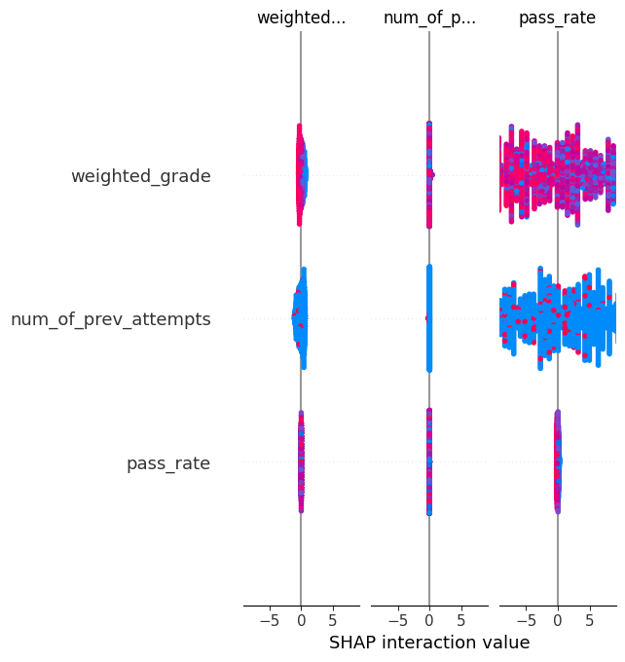
XAI FOR CNN
SHAP values assess feature contributions in CNN model predictions effectively.
Weighted grade impacts CNN prediction, adjusting the final output.
Previous attempts may negatively influence the prediction based on SHAP.
Pass rate shows its influence on the model’s decision-making process.
SHAP interaction values explain how feature combinations affect model predictions.
SHAP value range (-5 to 5) indicates feature contribution strength.
CNN uses convolutions to process spatial data for prediction insights.

Slide 38
ADVANCED TECHNIQUES

Slide 39
SOCIAL NETWORK ANALYSIS (SNA):
Purpose: Understand relationships among individuals, groups, or entities and how they influence behavior and decisions.
Method: Uses data from surveys, social media, or databases analyzed through graph theory, centrality, and community detection.
Key Measures:
Degree Centrality : finds highly connected individuals.
Betweenness Centrality : identifies bridge nodes.
Clustering : detects close-knit communities.
Applications:
Organizations: Improve communication and identify leaders.
Public Health: Track disease spread and target interventions.
Marketing: Find key influencers shaping opinions.
Academia: Study social dynamics and network evolution.

Slide 40
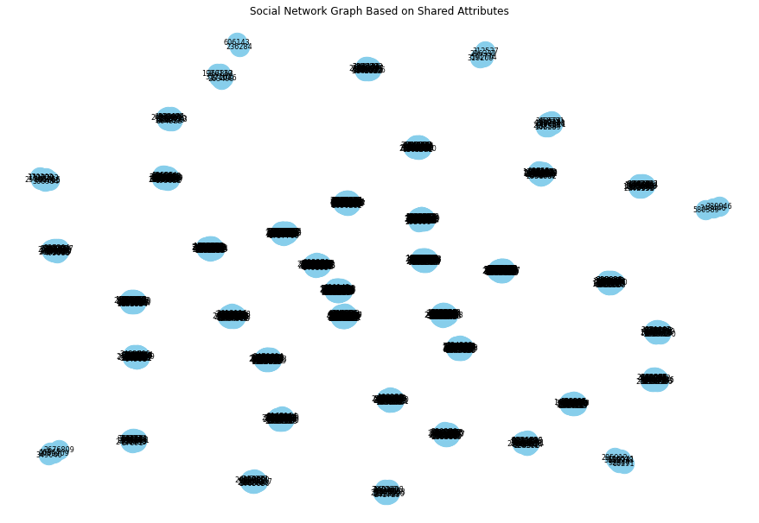
NETWORK PROPERTIES:
The network contains 965 nodes and 15,259 edges, showing dense connectivity.
Top 5 nodes by degree centrality: 65002, 268733, 2358969, 52130, 58873 these have high direct connections and strong influence.
Top 5 nodes by betweenness centrality: 52130, 58873, 65002, 74372, 116692 all have zero values, meaning they don’t act as bridges.
Indicates redundancy in their roles and strong intra-group connections but limited inter-group influence within the network.

Slide 41
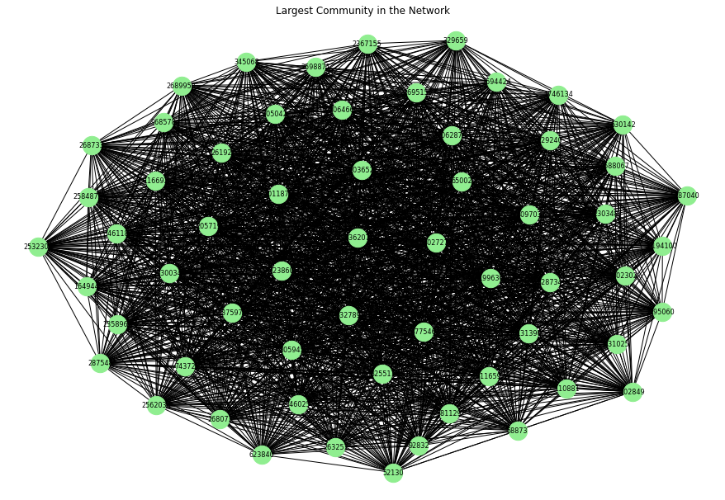
COMMUNITY

Slide 42
FEDERATED LEARNING
Definition: FL is a decentralized machine learning technique where clients collaboratively train a model without sharing raw data.
Process:
Each client updates the model with its local data.
Clients send only updated weights to the central server.
The server aggregates weights (using Federated Averaging) and distributes them back to clients for the next training round.
Study Setup:
Training of a fully connected neural network in a simulated FL environment.
5 clients involved in local training, with 8 federated rounds of weight aggregation.
Results:
Model Performance: Accuracy ranged from 56% to 83.3% across federated rounds.
Variability in Accuracy due to:
Non-IID data distribution among clients.
Scarcity of local training data.
Randomness in parameter initialization.

Slide 43
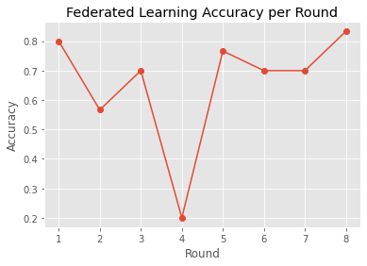
Challenges:
Slower convergence and less stability compared to centralized training.
Advantages:
Privacy-preserving model training.
Enables learning from geographically distributed data without sharing raw data.
Future Enhancements:
High local epochs, learning rate tuning, regularization, and advanced aggregation methods can improve accuracy and convergence.
Conclusion:
FL shows promise for privacy-preserving training in scenarios where centralization of data is challenging. However, there is potential for improving model performance and stability with further refinements.

Slide 44
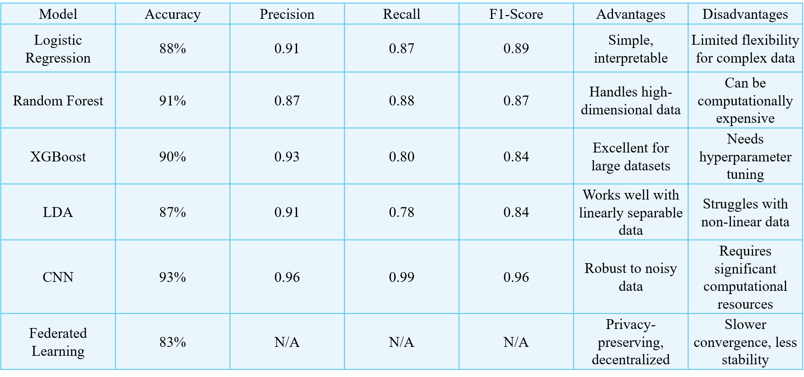
MODEL COMPARISON

Slide 45
MODEL COMPARISON
Logistic Regression: Simple and interpretable; best for binary outcomes.
Random Forest: Strong accuracy; robust against overfitting and outliers.
XGBoost: High performance; excels with complex, non-linear interactions.
LDA: Best for linearly separable datasets; offers good interpretability.
CNN: Excellent for complex, noisy data; requires large resources.
Federated Learning: Prioritizes privacy; decentralized learning but less stable.

Slide 46
CONCLUSION
The study explored multiple ML models for predicting student performance with focus on accuracy, interpretability, and privacy.
CNN achieved the highest accuracy (93%), handling complex interactions between weighted grade and pass rate.
Federated Learning (FL) offered strong data privacy, enabling collaboration without sharing sensitive information.
Logistic Regression, Random Forest, CNN, XGBoost, and LDA each showed unique strengths in handling different data types.
Overall, CNN was the most accurate, while Federated Learning proved ideal for balancing privacy and performance in educational systems.

Slide 47
FUTURE SCOPE
Enhancing Privacy: Combine Differential Privacy and Secure Multi-Party Computation (SMPC) with Federated Learning to protect data while keeping model performance strong.
Expanding Predictive Models:
Predict dropout rates for early student support.
Create individual learning plans through analytics.
Forecast student engagement to improve teaching.
Advanced Techniques: Use Transformer Models and Reinforcement Learning (RL) for smarter, personalized predictions.
Privacy-Preserving Integration: Improve Federated Learning with Deep Learning to achieve high accuracy while ensuring privacy and adaptability.

Slide 48
THANK YOU

